Slide 1


Arrays in Python

Slide 2

Learning Objective
In this lecture, we will learn what is an array, how is it different from list, how to create arrays in Python using NumPy package and which operations we can perform on numpy arrays.
Notes:
After this lecture, you shall be able to Explain why we need variables and what is their relation to the memory.

Slide 3
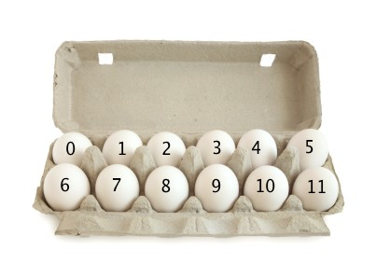
Why do we need Array? (Why)
Arrays are used when there is a need to use many variables of the same type. It can be defined as a sequence of objects which are of the same data type.
For example, to make a array of prices for daily grocery items. You create an array and add all numbers (prices) in this array.
Notes:
Programming sekhny ka maksad hia k ham apni real life problem computer ki madad sy solve ker sakhain.
Ham apni roz mara zindagi main bhot sary decision conditions ki base per lyty hain jesy k
Agr kal barish hoi to ham pick nick per jain gy
Agr aaj school ki chuti hoi to main cartoon daikoun ga
Or Agr kal mjy job mill gi to main aap ko party doun ga.
In conditions ko programming main handel kerny k leay conditional structure use hoty hain.

Slide 4
Why do we need array in Python?
Array is used to store multiple data of the same type. For example, an array of heigths of all students.
All data will be numerical in this.
Notes:
Programming sekhny ka maksad hia k ham apni real life problem computer ki madad sy solve ker sakhain.
Ham apni roz mara zindagi main bhot sary decision conditions ki base per lyty hain jesy k
Agr kal barish hoi to ham pick nick per jain gy
Agr aaj school ki chuti hoi to main cartoon daikoun ga
Or Agr kal mjy job mill gi to main aap ko party doun ga.
In conditions ko programming main handel kerny k leay conditional structure use hoty hain.

Slide 5
What is an array in Python?
Array is a sequence of same data type elements. The concept is to keep items of the same data type together.
Important terms that you can understand the concept of an array:
Element: Each item stored in an array
Index: A numerical index is assigned to each location of an element in an array and is used to identify the element.
Notes:
Programming sekhny ka maksad hia k ham apni real life problem computer ki madad sy solve ker sakhain.
Ham apni roz mara zindagi main bhot sary decision conditions ki base per lyty hain jesy k
Agr kal barish hoi to ham pick nick per jain gy
Agr aaj school ki chuti hoi to main cartoon daikoun ga
Or Agr kal mjy job mill gi to main aap ko party doun ga.
In conditions ko programming main handel kerny k leay conditional structure use hoty hain.

Slide 6
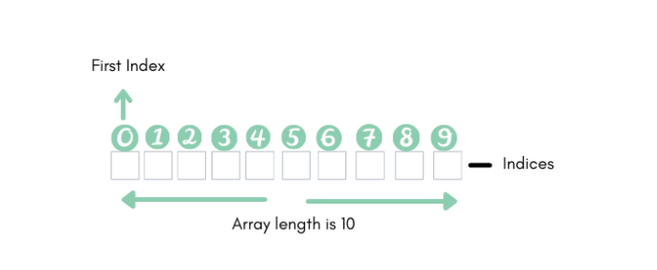
Representation of array in Python?
As you can see the representation of an array,
1. Index starts with 0
2. The length of the array is 10 that can store 10 elements.
Notes:
Programming sekhny ka maksad hia k ham apni real life problem computer ki madad sy solve ker sakhain.
Ham apni roz mara zindagi main bhot sary decision conditions ki base per lyty hain jesy k
Agr kal barish hoi to ham pick nick per jain gy
Agr aaj school ki chuti hoi to main cartoon daikoun ga
Or Agr kal mjy job mill gi to main aap ko party doun ga.
In conditions ko programming main handel kerny k leay conditional structure use hoty hain.

Slide 7
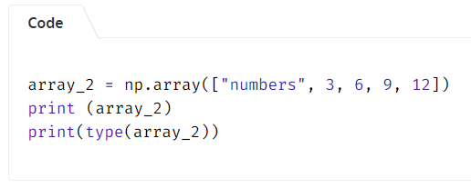

Creating an Array in Python?
In Python, an array can be created by the “array” module or by using NumPy package.
When using the array module to create arrays, all of the array’s elements must be of the same numeric type. But NumPy allows different datatypes within an array.
You’ll first have to import numpy package before using it in your program. (import numpy as np)

Slide 8
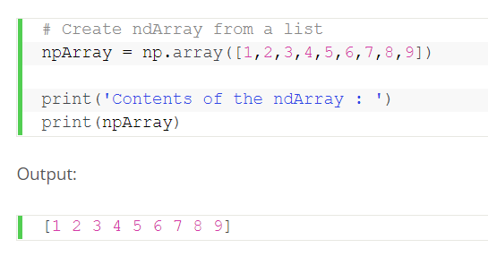
Creating an Array in Python?
Arrays can be created using existing data i.e. from lists.
For this purpose, we use array() method provided in numpy.
Notes:
Programming sekhny ka maksad hia k ham apni real life problem computer ki madad sy solve ker sakhain.
Ham apni roz mara zindagi main bhot sary decision conditions ki base per lyty hain jesy k
Agr kal barish hoi to ham pick nick per jain gy
Agr aaj school ki chuti hoi to main cartoon daikoun ga
Or Agr kal mjy job mill gi to main aap ko party doun ga.
In conditions ko programming main handel kerny k leay conditional structure use hoty hain.

Slide 9

Creating an Array from existing data?
Numpy provides different methods for creating an array from different types of existing data.
For example, numpy.asarray() method can be used for creating array from lists, tuples, list of tuples etc.
Notes:
Programming sekhny ka maksad hia k ham apni real life problem computer ki madad sy solve ker sakhain.
Ham apni roz mara zindagi main bhot sary decision conditions ki base per lyty hain jesy k
Agr kal barish hoi to ham pick nick per jain gy
Agr aaj school ki chuti hoi to main cartoon daikoun ga
Or Agr kal mjy job mill gi to main aap ko party doun ga.
In conditions ko programming main handel kerny k leay conditional structure use hoty hain.

Slide 10
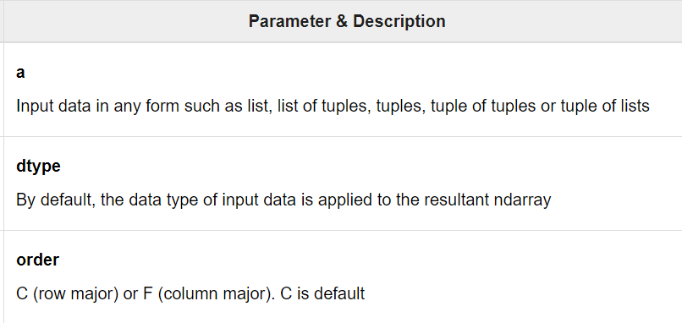
Creating an Array from existing data? (Cont.)
Description of different parameters which it takes is as follows:
Notes:
Programming sekhny ka maksad hia k ham apni real life problem computer ki madad sy solve ker sakhain.
Ham apni roz mara zindagi main bhot sary decision conditions ki base per lyty hain jesy k
Agr kal barish hoi to ham pick nick per jain gy
Agr aaj school ki chuti hoi to main cartoon daikoun ga
Or Agr kal mjy job mill gi to main aap ko party doun ga.
In conditions ko programming main handel kerny k leay conditional structure use hoty hain.

Slide 11
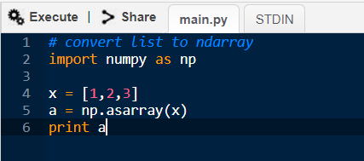
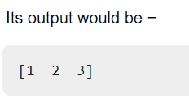
Creating an Array from existing data? (Cont.)
Code example:
Notes:
Programming sekhny ka maksad hia k ham apni real life problem computer ki madad sy solve ker sakhain.
Ham apni roz mara zindagi main bhot sary decision conditions ki base per lyty hain jesy k
Agr kal barish hoi to ham pick nick per jain gy
Agr aaj school ki chuti hoi to main cartoon daikoun ga
Or Agr kal mjy job mill gi to main aap ko party doun ga.
In conditions ko programming main handel kerny k leay conditional structure use hoty hain.

Slide 12
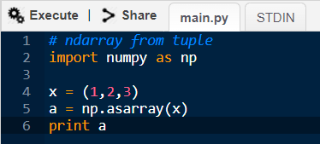
Creating an Array from existing data? (Cont.)
Code example 2 (creating array from tuple):
Notes:
Programming sekhny ka maksad hia k ham apni real life problem computer ki madad sy solve ker sakhain.
Ham apni roz mara zindagi main bhot sary decision conditions ki base per lyty hain jesy k
Agr kal barish hoi to ham pick nick per jain gy
Agr aaj school ki chuti hoi to main cartoon daikoun ga
Or Agr kal mjy job mill gi to main aap ko party doun ga.
In conditions ko programming main handel kerny k leay conditional structure use hoty hain.

Slide 13

Creating an Array from existing data?
numpy.frombuffer() method can be used for creating array from buffer (string).
Notes:
Programming sekhny ka maksad hia k ham apni real life problem computer ki madad sy solve ker sakhain.
Ham apni roz mara zindagi main bhot sary decision conditions ki base per lyty hain jesy k
Agr kal barish hoi to ham pick nick per jain gy
Agr aaj school ki chuti hoi to main cartoon daikoun ga
Or Agr kal mjy job mill gi to main aap ko party doun ga.
In conditions ko programming main handel kerny k leay conditional structure use hoty hain.

Slide 14
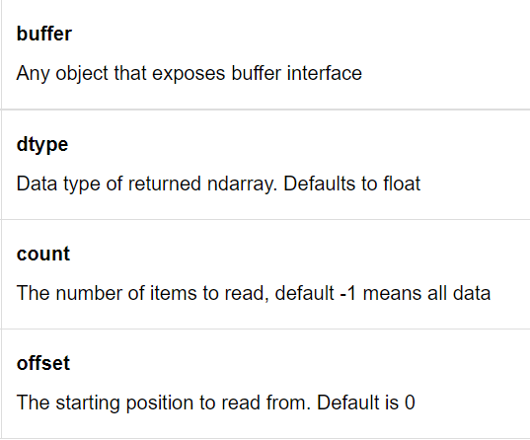
Creating an Array from existing data?
Description of parameters:
Notes:
Programming sekhny ka maksad hia k ham apni real life problem computer ki madad sy solve ker sakhain.
Ham apni roz mara zindagi main bhot sary decision conditions ki base per lyty hain jesy k
Agr kal barish hoi to ham pick nick per jain gy
Agr aaj school ki chuti hoi to main cartoon daikoun ga
Or Agr kal mjy job mill gi to main aap ko party doun ga.
In conditions ko programming main handel kerny k leay conditional structure use hoty hain.

Slide 15
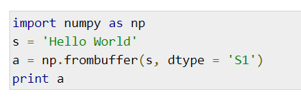
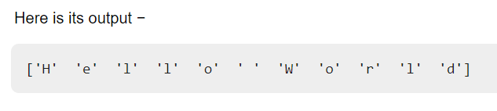
Creating an Array from existing data?
Code example (buffer to array):
Notes:
Programming sekhny ka maksad hia k ham apni real life problem computer ki madad sy solve ker sakhain.
Ham apni roz mara zindagi main bhot sary decision conditions ki base per lyty hain jesy k
Agr kal barish hoi to ham pick nick per jain gy
Agr aaj school ki chuti hoi to main cartoon daikoun ga
Or Agr kal mjy job mill gi to main aap ko party doun ga.
In conditions ko programming main handel kerny k leay conditional structure use hoty hain.

Slide 16

Creating an Array from existing data?
numpy.fromiter() function builds an ndarray object from any iterable object. A new one-dimensional array is returned by this function.
Notes:
Programming sekhny ka maksad hia k ham apni real life problem computer ki madad sy solve ker sakhain.
Ham apni roz mara zindagi main bhot sary decision conditions ki base per lyty hain jesy k
Agr kal barish hoi to ham pick nick per jain gy
Agr aaj school ki chuti hoi to main cartoon daikoun ga
Or Agr kal mjy job mill gi to main aap ko party doun ga.
In conditions ko programming main handel kerny k leay conditional structure use hoty hain.

Slide 17
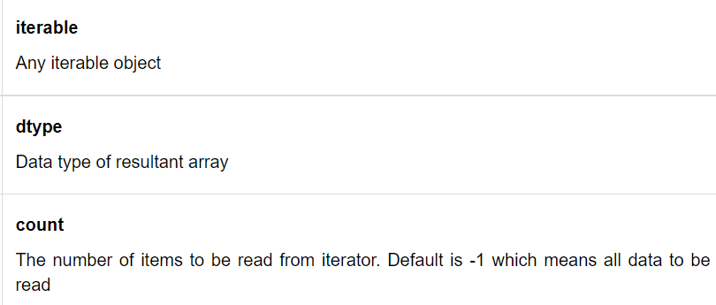
Creating an Array from existing data?
Description of parameters:
Notes:
Programming sekhny ka maksad hia k ham apni real life problem computer ki madad sy solve ker sakhain.
Ham apni roz mara zindagi main bhot sary decision conditions ki base per lyty hain jesy k
Agr kal barish hoi to ham pick nick per jain gy
Agr aaj school ki chuti hoi to main cartoon daikoun ga
Or Agr kal mjy job mill gi to main aap ko party doun ga.
In conditions ko programming main handel kerny k leay conditional structure use hoty hain.

Slide 18
Creating an Array from existing data?
Code example (buffer to array):
Notes:
Programming sekhny ka maksad hia k ham apni real life problem computer ki madad sy solve ker sakhain.
Ham apni roz mara zindagi main bhot sary decision conditions ki base per lyty hain jesy k
Agr kal barish hoi to ham pick nick per jain gy
Agr aaj school ki chuti hoi to main cartoon daikoun ga
Or Agr kal mjy job mill gi to main aap ko party doun ga.
In conditions ko programming main handel kerny k leay conditional structure use hoty hain.

Slide 19
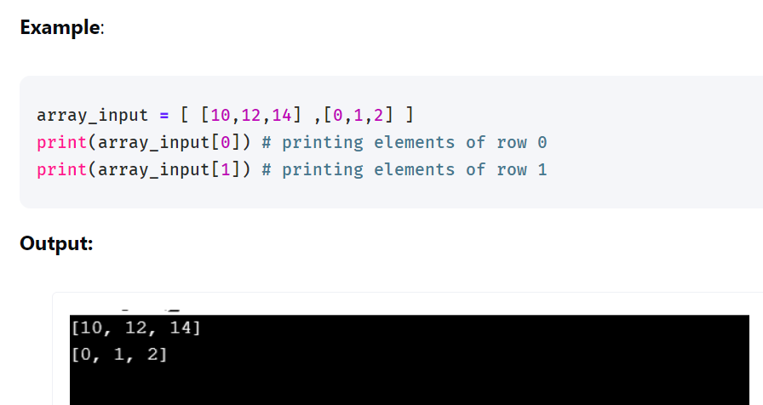
Dimensionality of Arrays in Python?
Arrays can be of multiple dimensions. Lets look at 2D arrays.
Two-dimensional arrays are basically array within arrays. Here, the position of a data item is accessed by using two indices. It is represented as a table of rows and columns of data items.
Notes:
Programming sekhny ka maksad hia k ham apni real life problem computer ki madad sy solve ker sakhain.
Ham apni roz mara zindagi main bhot sary decision conditions ki base per lyty hain jesy k
Agr kal barish hoi to ham pick nick per jain gy
Agr aaj school ki chuti hoi to main cartoon daikoun ga
Or Agr kal mjy job mill gi to main aap ko party doun ga.
In conditions ko programming main handel kerny k leay conditional structure use hoty hain.

Slide 20
Lists vs Arrays in Python?
Arrays need to be declared. Lists don't: since they are built into Python. In previous lectures, you saw that lists are created by simply enclosing a sequence of elements into square brackets. Creating an array, on the other hand, requires a specific function from either the array module (i.e., array.array()) or NumPy package (i.e., numpy.array()).
Arrays can store data very compactly and are more efficient for storing large amounts of data.
Arrays are great for numerical operations; lists cannot directly handle math operations. For example, you can divide each element of an array by the same number with just one line of code. If you try the same with a list, you'll get an error.

Slide 21
Attributes of an array?
Numpy’s array class is called ndarray. It is also known by alias name array.
This class contains some important attributes (or variables) which can give us information about different characteristics of the array.
We’ll discuss different attributes of numpy array (ndarray) in next slides.
Notes:
Programming sekhny ka maksad hia k ham apni real life problem computer ki madad sy solve ker sakhain.
Ham apni roz mara zindagi main bhot sary decision conditions ki base per lyty hain jesy k
Agr kal barish hoi to ham pick nick per jain gy
Agr aaj school ki chuti hoi to main cartoon daikoun ga
Or Agr kal mjy job mill gi to main aap ko party doun ga.
In conditions ko programming main handel kerny k leay conditional structure use hoty hain.

Slide 22
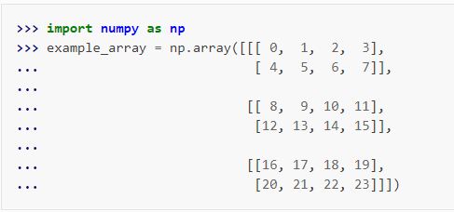
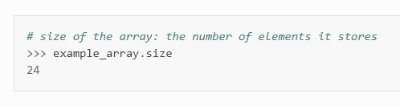
Attributes of an array? (size)
The ‘size’ attribute gives the total number of elements in the array.
The total number of elements of the array. This is equal to the product of the elements of the array’s shape.
Notes:
Programming sekhny ka maksad hia k ham apni real life problem computer ki madad sy solve ker sakhain.
Ham apni roz mara zindagi main bhot sary decision conditions ki base per lyty hain jesy k
Agr kal barish hoi to ham pick nick per jain gy
Agr aaj school ki chuti hoi to main cartoon daikoun ga
Or Agr kal mjy job mill gi to main aap ko party doun ga.
In conditions ko programming main handel kerny k leay conditional structure use hoty hain.

Slide 23
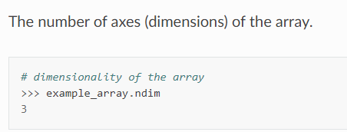
Attributes of an array? (ndim)
The ‘ndim’ attribute represents the number of dimensions or axes of the array. The number of dimensions is also referred to as ‘rank’.
For a single dimensional array, it is 1 and for a two dimensional array, it is 2.

Slide 24
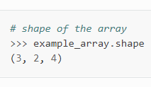
Attributes of an array? (shape)
The ‘shape’ attribute gives the shape of an array. The shape is a tuple listing the number of elements along each dimension. A dimension is called an axis.
For a 1D array, shape gives the number of elements in the row.
For a 2D array, it specifies the number of rows and columns in each row. We can also change the shape using ‘shape’ attribute.
Notes:
Programming sekhny ka maksad hia k ham apni real life problem computer ki madad sy solve ker sakhain.
Ham apni roz mara zindagi main bhot sary decision conditions ki base per lyty hain jesy k
Agr kal barish hoi to ham pick nick per jain gy
Agr aaj school ki chuti hoi to main cartoon daikoun ga
Or Agr kal mjy job mill gi to main aap ko party doun ga.
In conditions ko programming main handel kerny k leay conditional structure use hoty hain.

Slide 25

Attributes of an array? (dtype)
An attribute describing the data type of the elements in the array.
Recall that NumPy’s ND-arrays are homogeneous: they can only posses numbers of a uniform data type.
Notes:
Programming sekhny ka maksad hia k ham apni real life problem computer ki madad sy solve ker sakhain.
Ham apni roz mara zindagi main bhot sary decision conditions ki base per lyty hain jesy k
Agr kal barish hoi to ham pick nick per jain gy
Agr aaj school ki chuti hoi to main cartoon daikoun ga
Or Agr kal mjy job mill gi to main aap ko party doun ga.
In conditions ko programming main handel kerny k leay conditional structure use hoty hain.

Slide 26
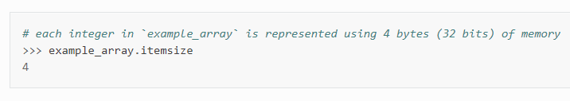
Attributes of an array? (itemsize)
The ‘itemsize’ attribute gives the memory size of the (single) array element in bytes.
As we know, 1 byte is equal to 8 bits.
Notes:
Programming sekhny ka maksad hia k ham apni real life problem computer ki madad sy solve ker sakhain.
Ham apni roz mara zindagi main bhot sary decision conditions ki base per lyty hain jesy k
Agr kal barish hoi to ham pick nick per jain gy
Agr aaj school ki chuti hoi to main cartoon daikoun ga
Or Agr kal mjy job mill gi to main aap ko party doun ga.
In conditions ko programming main handel kerny k leay conditional structure use hoty hain.

Slide 27

Attributes of an array? (nbytes)
The ‘nbytes’ attribute gives the total number of bytes occupied by an array.
The total number of bytes = size of the array * item size of each element in the array.
Notes:
Programming sekhny ka maksad hia k ham apni real life problem computer ki madad sy solve ker sakhain.
Ham apni roz mara zindagi main bhot sary decision conditions ki base per lyty hain jesy k
Agr kal barish hoi to ham pick nick per jain gy
Agr aaj school ki chuti hoi to main cartoon daikoun ga
Or Agr kal mjy job mill gi to main aap ko party doun ga.
In conditions ko programming main handel kerny k leay conditional structure use hoty hain.

Slide 28
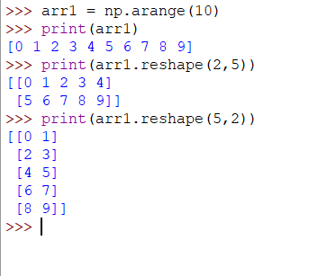
Attributes of an array? (reshape())
The ‘reshape()’ method is useful to change the shape of an array. The new array should have the same number of elements as in the original array.
Notes:
Programming sekhny ka maksad hia k ham apni real life problem computer ki madad sy solve ker sakhain.
Ham apni roz mara zindagi main bhot sary decision conditions ki base per lyty hain jesy k
Agr kal barish hoi to ham pick nick per jain gy
Agr aaj school ki chuti hoi to main cartoon daikoun ga
Or Agr kal mjy job mill gi to main aap ko party doun ga.
In conditions ko programming main handel kerny k leay conditional structure use hoty hain.

Slide 29
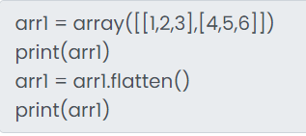

Attributes of an array? (flatten())
The flatten() method is useful to return a copy of the array collapsed into one dimension.
So if the array is multidimensional, array will be converted to 1D.
Notes:
Programming sekhny ka maksad hia k ham apni real life problem computer ki madad sy solve ker sakhain.
Ham apni roz mara zindagi main bhot sary decision conditions ki base per lyty hain jesy k
Agr kal barish hoi to ham pick nick per jain gy
Agr aaj school ki chuti hoi to main cartoon daikoun ga
Or Agr kal mjy job mill gi to main aap ko party doun ga.
In conditions ko programming main handel kerny k leay conditional structure use hoty hain.

Slide 30

Self Assessment
Solve the Following Programs
Write a program to create array from lists.
Write a program to create an array from tuple.
Write a program to create an array from list of tuples?

Slide 31
Self Assessment
Solve Following Programs
Write a Program that creates array with multiple dimensions.
Write a program that prints different attributes of an array.

Slide 32
Self Assessment
Solve Following Programs
Write a program to reshape an array.
Convert a 3D array into 1D array.

